Slide 1

A
Presentation On CURRENCY
CONVERSION SYSTEM
Presented By
Sonam Sahu
BCA 5th Sem.
Guided By
Akanksha Sahu
Department Of
Computer Science Engg.
BHARTI VISHWAVIDYALAYA , PULGAON
CHOWK, DURG
Session – 2024-25

Slide 2
CURRENCY
CONVERTER

Slide 3
Introduction
A currency converter is a tool that calculates the equivalent value of one currency in another, using current exchange rates. It’s widely used in international trade, travel, and finance to compare prices, make informed transactions, and manage cross-border expenses efficiently and accurately.
In this project,
By the knowledge of usage of currency converter a program is designed using basic knowledge of (Html, CSS and Javascript)

Slide 4
Purpose
In finance, an exchange rate between two currencies is the rate at which one country will be exchanged for another.
It is a useful tool which gives us the value of certain amount of one currency to be converted in to a different currency.
It is also regarded as the value of one country’s currency in terms of another currency.
In this project we are going to display a web window in which currency options are given and the conversion value is displayed.

Slide 5
Advantages
Convenient to use
Owing to these online tools, you no longer need to visit physical banks or currency exchange centers for accurate currency conversion. The currency conversion facility is at your fingertips now!
2. Time-saving
As stated in the section above, you don’t have to visit world banks or currency
exchange centers to convert a currency value to the desired currency value.
This in turn can help you save time and energy
3. Budget planning
As a student studying abroad, a professional on an international business trip,
or a tourist traveling overseas, you need to manage a budget and plan your expenses.
4. Precise financial reporting
Precise and error-free financial reporting is crucial for investor relations,
compliance, and strategic financial planning in organizations.

Slide 6
Disadvantages
1. Compliance with Regulations
The primary disadvantage of developing a currency converter app is that keeping the app updated and adhering to compliance according to the financial regulations is important, and implementing the necessary features according to the rules and regulations can be a challenging task during the mobile app development process.
2. Internet Dependencies
Another disadvantage of a currency converter app is that these apps rely on an active internet connection to fetch accurate exchange rates, which might hamper the conversion process thus creating a negative impact on the user experience of the app.

Slide 7
Project Category:
Web-Based Application Available
Technologies: Languages: HTML, CSS, JS.
Web Server: any brower
Development Platform: VS Code
Tools Used:
VS Code, Currency Conversion API
Operating System: Windows 10

Slide 8
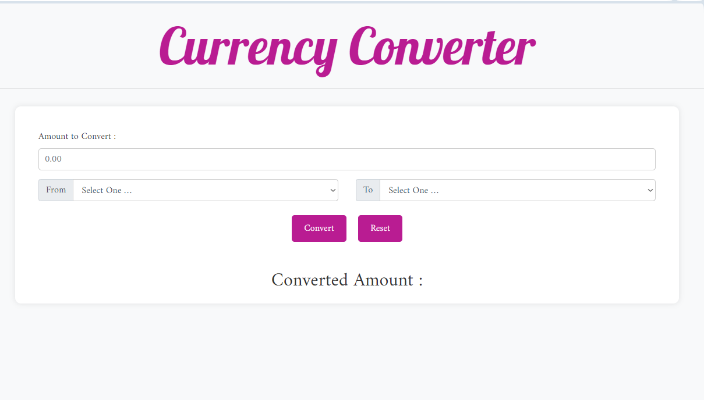
First View

Slide 9
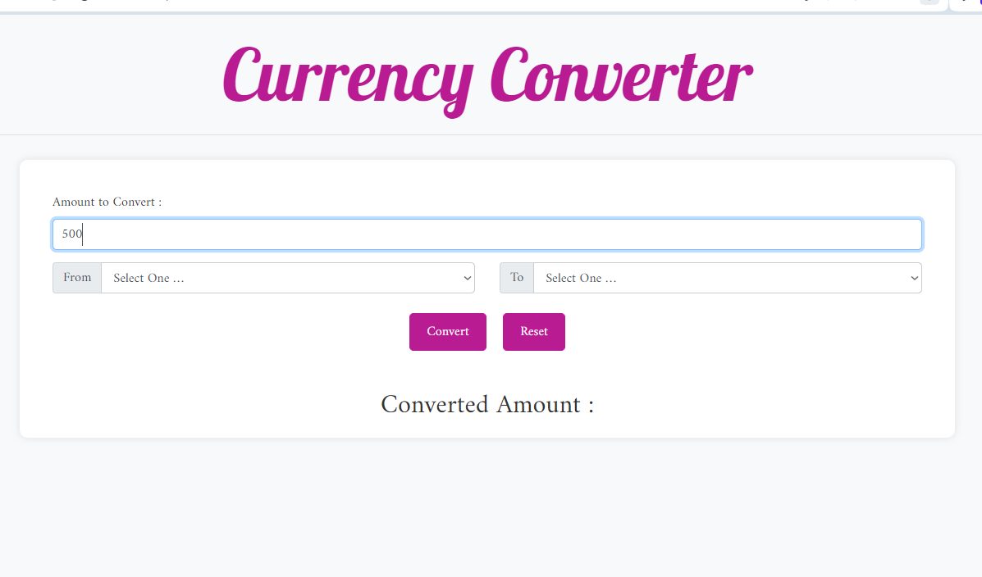
Amount

Slide 10
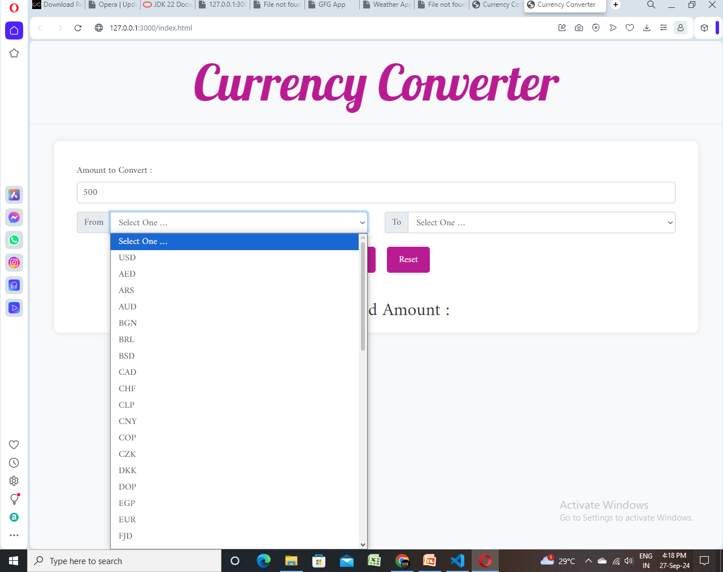
Type selection
Notes:
ATTENDANCE

Slide 11
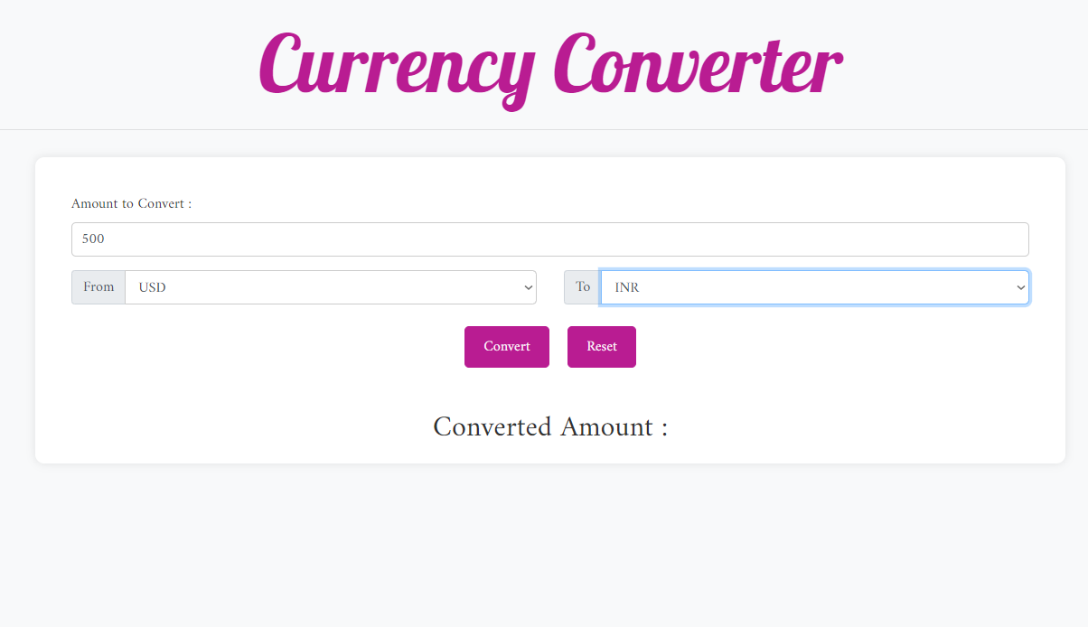
Notes:
PAYROLL LIST

Slide 12
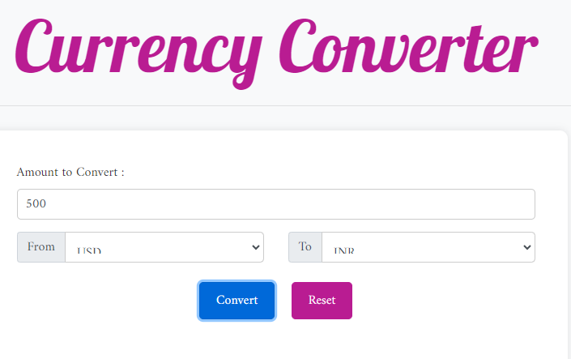
Convert:- Convert one currency into another currency.
Notes:
DEPARTMENT LIST

Slide 13
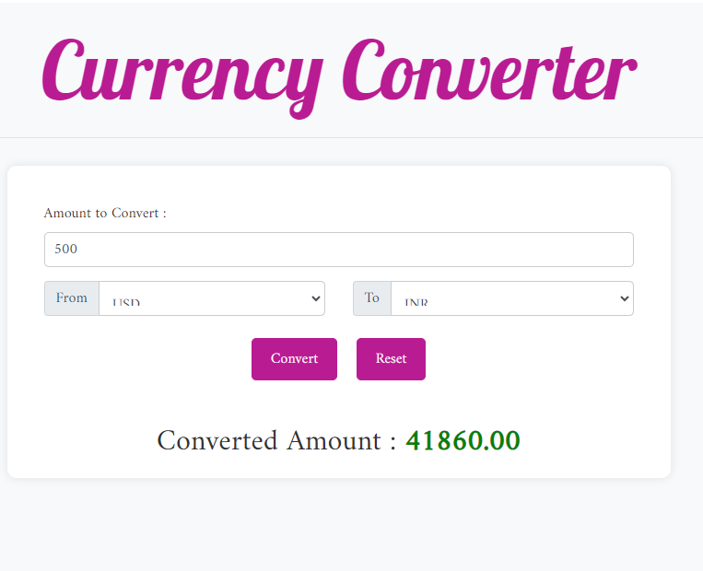
Notes:
POSITION LIST

Slide 14
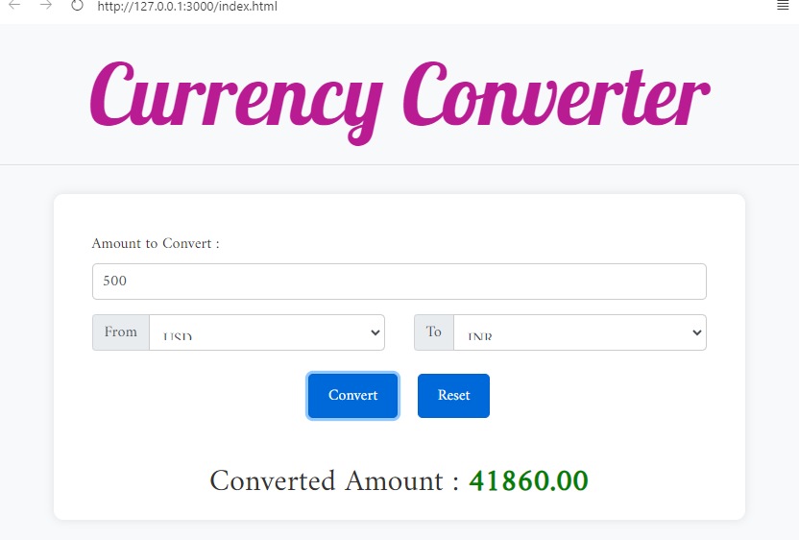
Reset
Notes:
ALLOWANCE LIST

Slide 15
THANK YOU
Notes:
THANK YOU

